Slide 1

Walmart Data Analysis using Power BI
By Louisha Nancy J
DM21

Slide 2
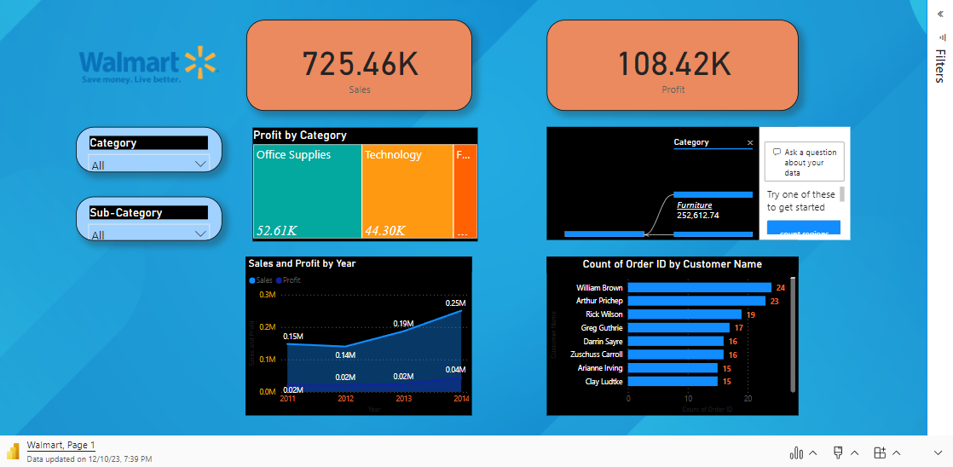
Consolidated Dashboard

Slide 3
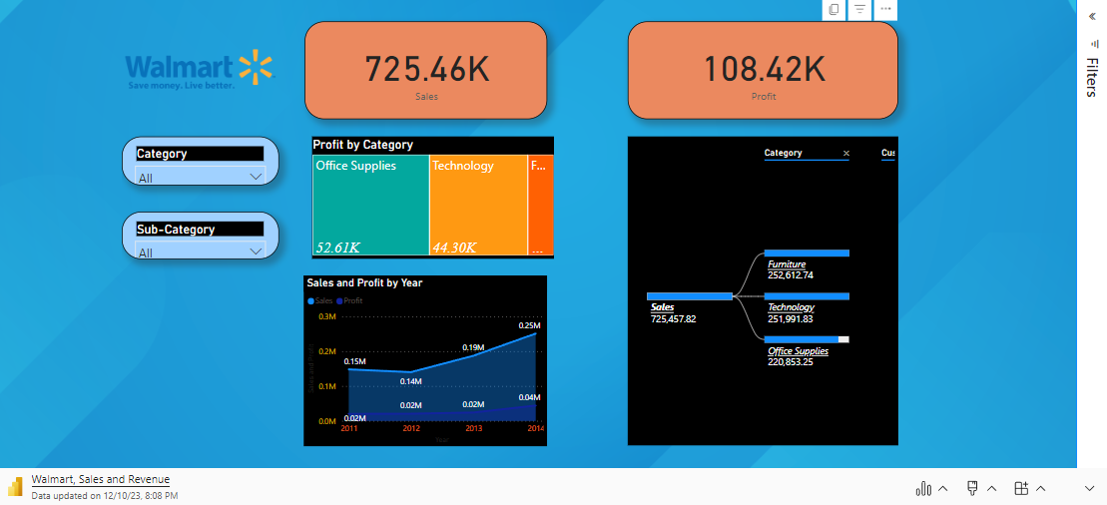
Sales and Revenue Dashboard

Slide 4
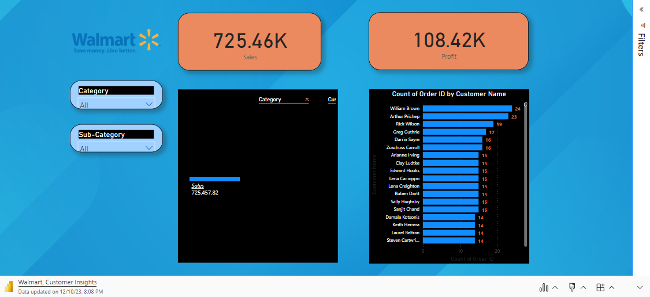
Customer Insights

Slide 5
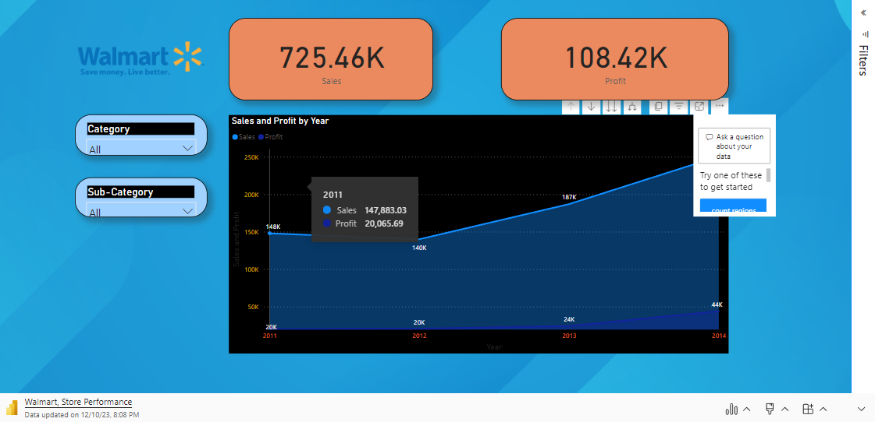
Store Performance

Slide 6
Summary
Positive Performance Trends:
Significant year-on-year (YOY) growth observed in Furniture and Technology supplies categories for FY 2011-2012.
Remarkable increase in sales and profitability, indicating successful strategies and high demand in these segments.
Challenges Identified:
Office Supplies category experienced a decline in sales and profitability during the same period.
Noted a decrease in performance within this category, requiring further investigation into underlying factors.
Store Performance Overview:
Overall store performance was positive, primarily driven by robust growth in Furniture and Technology supplies.
Acknowledged the need to address challenges in the Office Supplies category to maintain a balanced store performance.

